Slide 1

FLORA CLASSIFIER USING MACHINE
LEARNING
GUIDE NAME:Ms.S.Murugavalli.,ME.,(Ph.D)
TEAM MEMBERS:
SANGEETHA S (811721243047)
UDHAYAMALATHI N (811721243059)
VASANTHA PRIYA M (811721243060)
1

Slide 2
OBJECTIVE
To create innovative system that seamlessly combines image recognition and information retrieval for plant enthusiasts cultivating greenery at home. The user-friendly interface allows easy image uploads or manual input, and upon classification, users receive detailed plant profiles, enhancing their understanding and care of the identified plants.

Slide 3
PROBLEM DEFINITION
Existing System:
The existing system provides a categorization based on their growth habits, such as trees, shrubs, vines, herbs, or succulents.It make classification on the structure of leaf and flower.
Proposed System:
Develops an app integrating deep learning for image captioning, employing The system aims to provide accurate and reliable identification of home-grown plants, Provides cultivation guidelines, care instructions, and detailed insights into the medicinal uses of the identified species, fostering a holistic understanding of home flora.

Slide 4
LITERATURE SURVEY
S.NO | PAPER TITLE | AUTHOR NAME | YEAR PUBLISHED | TECHNIQUE USED | DEMERITS
1. | Medicinal Plant identification in the wild by using CNN. | Trung Nguyen Quoc, Vinh Truong Hoang. | 2020 | Convolutional neural network(cnn), recurrent neural network(rnn) | Limited Generalization and dependency on data quality.
2. | Plant Identification Using Machine Learning. | Surjit Kumar, Gauri Katiyar, Rahul Chandola | 2021 | Image Recognition, Feature Extraction. | Limited dataset, Ethical consideration, Deployment resources.

Slide 5
S.NO | PAPER TITLE | AUTHOR NAME | YEAR PUBLISHED | TECHNIQUE USED | DEMERITS
3. | Arg-Cnn: An Attention-Based Network for Plant Identification. | Wenyu Zhang, Min Yuan, Wei Zhao. | 2022 | CNN,Training methodology, Loss function, Optimization algorithm. | Training data dependency, Overfitting, Interpretability.
4. | Accurate Medicinal Plant Identification in Natural Environments by Embedding Mutual Information in a Convolution Neural Network Model. | Laurence S. Dooley, Patrick Wong, Lida Shahmiri. | 2022 | Data collection, Feature Extraction, CNN, Mutual information Embedding. | Complexity and computational cost,Ethical consideration.

Slide 6
S.NO | PAPER TITLE | AUTHOR NAME | YEAR PUBLISHED | TECHNIQUE USED | DEMERITS
5. | Research on Plant Image Identification Based on Deep Learning. | Xianfeng Zeng, Jing Chang, Changxiu Dai. | 2022 | Deep learning, CNN,Transfer learning, Evaluation metrics. | Long Training times, Data dependency, Overfitting.
6. | Automatic Plant Recognition: A Survey of Relevant Algorithms. | Noor Aini Mohd Roslan, Zaidah Ibrahim. | 2022 | Deep learning, Machine learning, Transfer learning, Geometric and spatial information. | Data Requirements, Hardware and processing Requirement

Slide 7
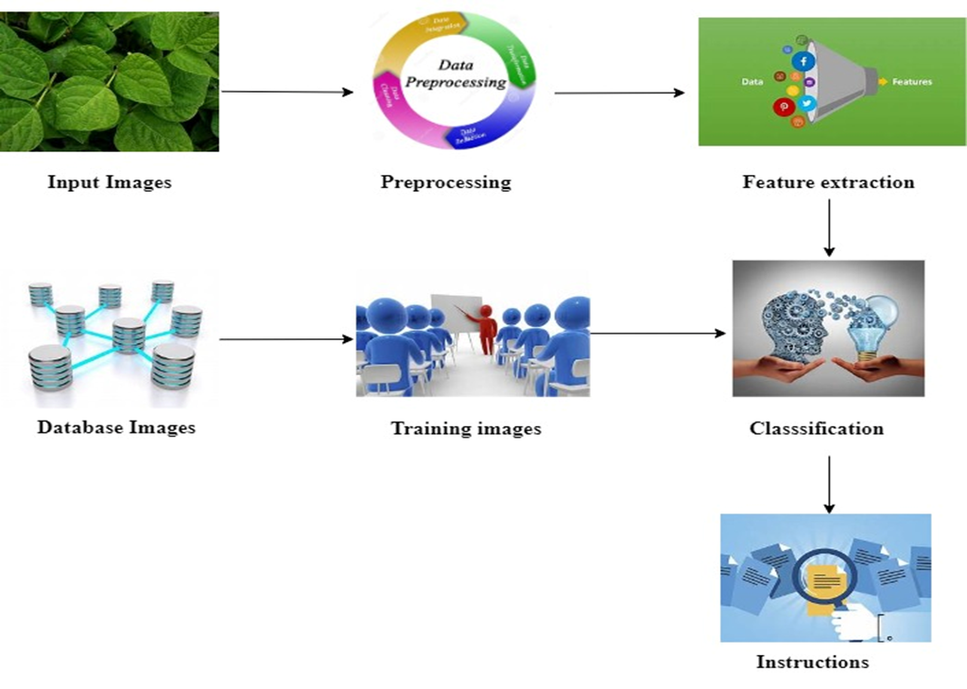
ARCHITECTURE DIAGRAM

Slide 8
SYSTEM SPECIFICATION
HARDWARE SPECIFICATION :
Processing Power: A Multicore processor
Memory (RAM): At least 8 GB of RAM.
Storage: AnSSD
Graphics Card (Optional)
SOFTWARE SPECIFICATION :
Operating System: Windows, macOS, or Linux platforms.
Python.
Deep Learning Frameworks: TensorFlow, PyTorch, Keras.
Image Processing Libraries: Libraries like OpenCV.

Slide 9
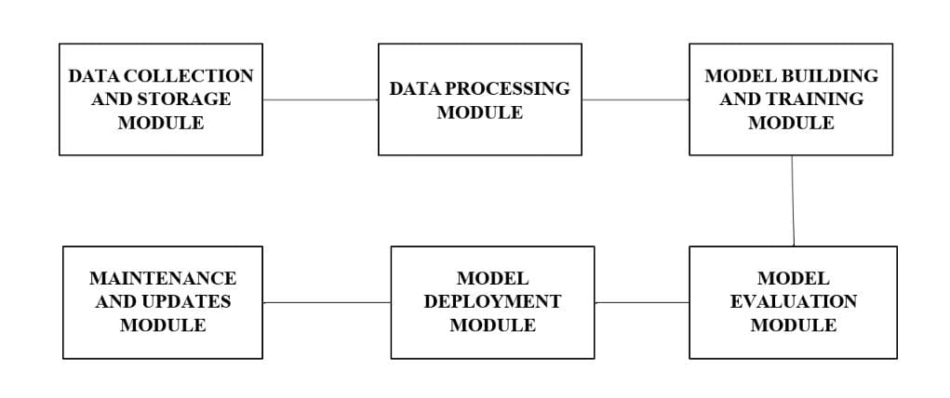
MODULES

Slide 10
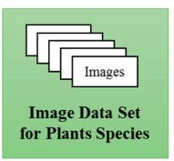
DATA COLLECTION AND STORAGE MODULE
SUB MODULE 1: DATASET COLLECTION.
Image Data Collection.
Annotation and Labeling.
Feature Extraction.
SUB MODULE 2:DATABASE MANAGEMENT
(FOR STORING METADATA).
Database Creation.
Machine Learning Models.
Continuous Improvement.

Slide 11
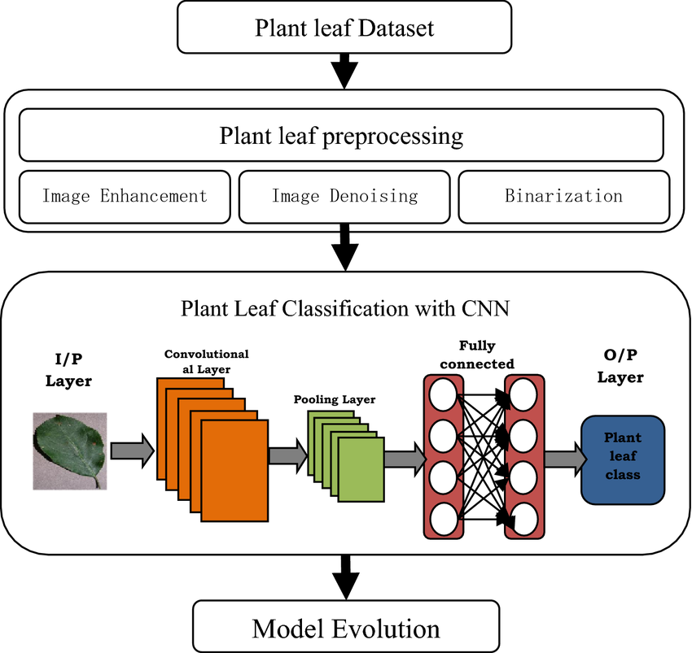
DATA PROCESSING MODULE
SUB MODULE 1: IMAGE PREPROCESSING
Normalization
Noise Reduction
Feature Extraction
SUB MODULE 2: DATA SPLITTING
Training Set
Validation Set
Testing Set

Slide 12
MODEL BUILDING AND TRAINING MODULE
SUB MODULE 1: CNN ARCHITECTURE DESIGN
Image recognition tasks
Designing the architecture
SUB MODULE 2: HYPER PARAMETER TUNING
Optimizing various parameters
Techniques like grid search in hyper parameters
SUB MODULE 3:TRANSFER LEARNING
Retraining the pre-trained model
Leveraging features

Slide 13
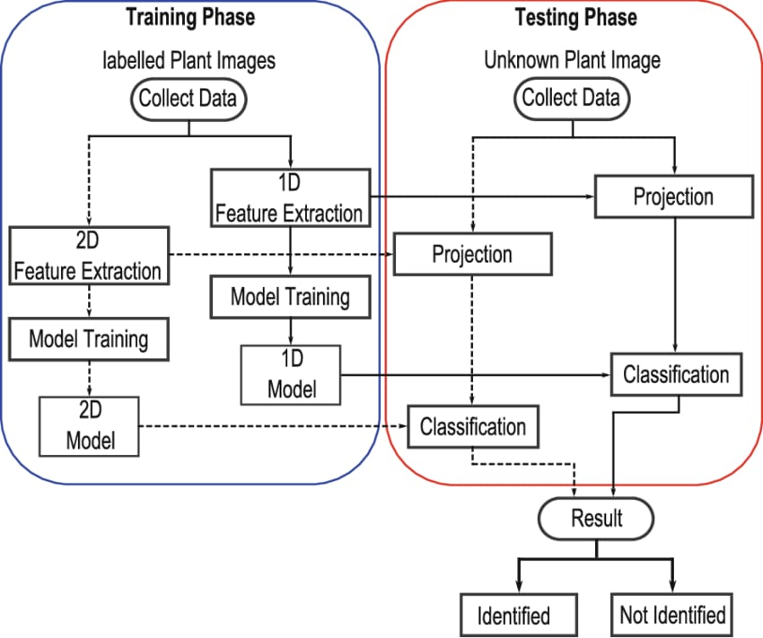

Slide 14
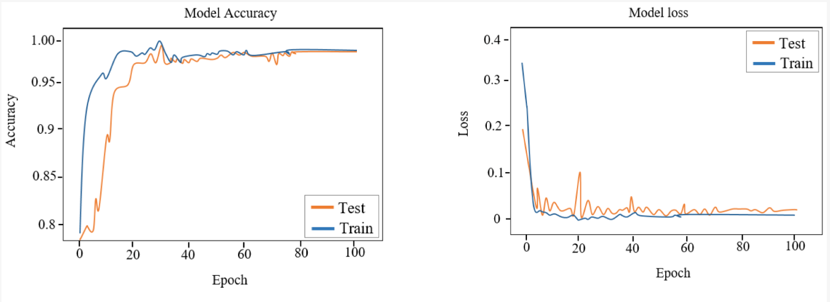
MODEL EVALUATION MODULE
SUB MODULE 1: METRICS CALCULATION.
Accuracy.
Precision.
Recall (Sensitivity).
F1 Score.
Confusion Matrix.
ROC Curve and AUC.
SUB MODULE 2: VISUALIZATION.
Loss and Accuracy Curves.
Confusion Matrix Visualization.
Feature Maps.

Slide 15
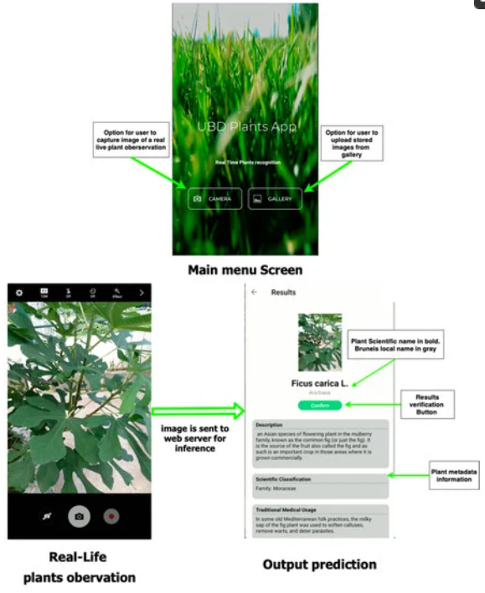
MODEL DEPLOYMENT MODULE
SUB MODULE 1:APPLICATION LAYER
(WEB, MOBILE, DESKTOP)
User Interface
Frontend Development
Backend Development
SUB MODULE 2: API IMPLEMENTATION
API Integration
API Documentation
SUB MODULE 3: SERVER DEPLOYMENT
Server Setup
Scalability and Performance

Slide 16
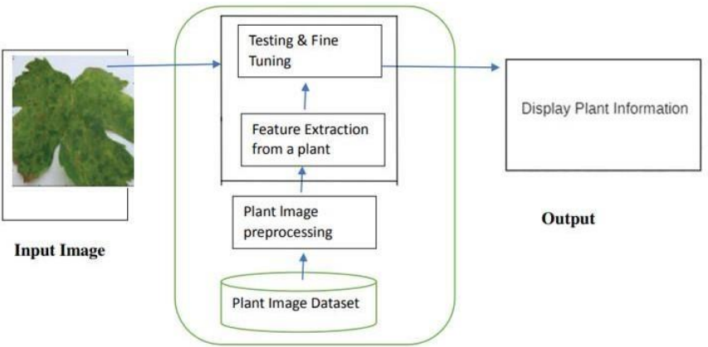
MAINTENANCE AND UPDATES MODULE
SUB MODULE 1: MODEL UPDATES
Retraining
Fine-Tuning
Version Control
SUB MODULE 2: DATA UPDATES
Data Augmentation
Labeling Updates
Quality Assurance
SUB MODULE 3:SOFTWARE UPDATES
Framework and Library Updates
Security Patches

Slide 17
APPLICATIONS
Utilize machine learning to classify plant species from images provided by users.
Develop an intuitive interface for users.
Train the model on a diverse dataset of plant images to ensure accurate classification.
Allow users to provide feedback on classification results.
Prioritize user privacy and data security.

Slide 18
CONCLUSION
The system's commitment to providing comprehensive plant information, including medicinal insights, enhances its educational value, with an intuitive interface and user-centric design.Positioned as a valuable tool for both beginners and experienced gardeners, it aspires to redefine plant-related applications, promoting sustainable and informed home gardening practices.Leveraging advanced image recognition, it ensures precise plant identification.

Slide 19
REFERENCES
1.Wäldchen, J., & Mäder, P.,(2018)Plant Classification Using Deep Neural Networks.
2.S.Kannan, P. Arivazhagan, S. Raja, P. I. Lazarus, & C. Immanuel Selvaraj
Procedia(2018)Plant Species Identification Using Deep Convolutional Neural Network.
3.Neeraj Kumar, Peter N. Belhumeur, Arijit Biswas, David W. Jacobs, W. John Kress, Ida C. Lopez,(2022)Medicinal Plant identification in the wild by using CNN.

Slide 20
THANK YOU

